Slide 1
Basic Principles of Organic Chemistry

Slide 2
Introduction of Organic Chemistry
We used to describe organic chemistry as the chemistry of living things.
Since the chemistry of living things is based on carbon, the chemistry of carbon compounds has come to be known as Organic Chemistry.
It now includes the study of carbon compounds which are not found in living things and so is an incredibly large branch of modern chemistry.
Organic compounds are the hydrocarbons and their derivatives and organic chemistry is that branch of chemistry that deals with the study of these compounds

Slide 3
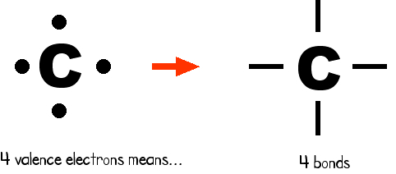
Tetravalency of carbon
The atomic number of Carbon is 6 and its electronic configuration is 2,4 i.e. it has 4 valence electrons.
Electronic configuration of Carbon
C 1s² 2s² 2p²
It has a “central” role in all living organisms.
It has 4 valence electrons.
It makes 4 covalent bonds.
It can bond with any element, but really loves to bond with other carbon atoms and make long chains

Slide 4
IUPAC System of Nomenclature of Organic Compounds
IUPAC (International Union of Pure and Applied Chemistry) have evolved a systematic and logical way to write the names of millions of organic compounds from their structure and write the structure back from their names in order to ensure uniformity in naming across the world. Many substances in addition to IUPAC names also have common name.

Slide 5
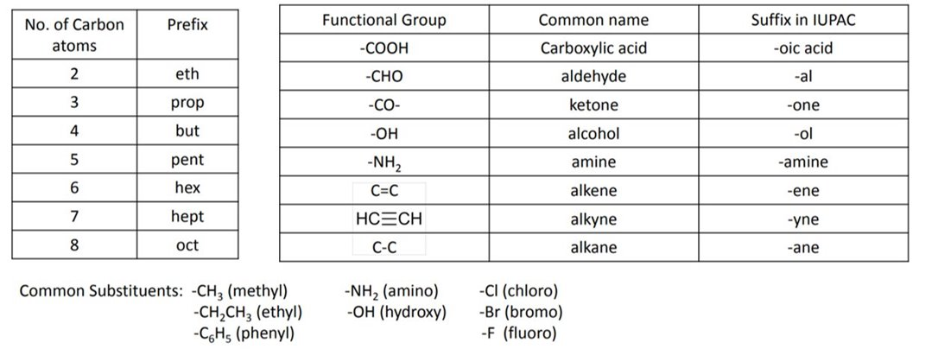
A functional group is a group of atoms or bonds inside a substance that is responsible for the substance's unique chemical reactions in organic chemistry.

Slide 6
The IUPAC name of every organic molecule broadly has 3 parts:
• The parent or root name indicates the number of carbons in the longest continuous chain.
• The suffix indicates what functional group is present.
• The prefix tells us the identity, location, and number of substituents attached to the carbon chain.

Slide 7
Functional Groups
Functional group: An atom or group of atoms within a molecule that shows a characteristic set of physical and chemical properties.
Functional groups are important for three reason; they are
1. The units by which we divide organic compounds into classes
2. The sites of characteristic chemical reactions
3. The basis for naming organic compounds

Slide 8
Important Functional Groups

Slide 9
A. Naming compounds having no functional group (For alkanes)
First of all let us try to understand IUPAC nomenclature rules for hydrocarbons having all single bonds or straight chain, i.e. for alkanes.
Alkanes: The acyclic or open chain hydro saturated compounds are called alkanes. They are also known as paraffins (parum = little; affins = affinity) as they have very little affinity towards reagents. In other words, they are relatively unreactive towards most of the reagents
Their general formula is CnH2n+2 where n = 1, 2, 3 ...
Example: CH4 (methane), C2H6 (ethane), C3H8 (propane) and so on.

Slide 10
Rules for IUPAC Nomenclature
All organic compounds are considered as derived from some parent alkane.
The longest continuous chain of carbon atoms is identified as the parent chain and the number of carbon atoms in this chain decides the root name of the compound as corresponding “alk”. (Note that in simple hydrocarbons, a methyl group cannot be at position 1; an ethyl group cannot be present at position 2; an n-propyl group cannot be present at position 3 and so on.)

Slide 11
3. The carbon atoms of the longest continuous parent chain are numbered using the Arabic numerals i.e. 1, 2, 3, 4 ..., etc. from one end to the other end in such a manner that the carbon of the chain having a substituent gets the lowest number.

Slide 12
If there are more than one substituent or branch, numbering of the parent chain is done in such a manner that the sum of the numbers given to the carbon atoms of the chains having substituents, is minimum. This is known as the lowest sum rule. The numeral that locates the position of a substituent is known as a locant.

Slide 13
To name the compound, the name of the substituent preceded by its locant is prefixed to the name of the parent alkane.
If there are more than one substituent, then each substituent preceded by its locant is placed in alphabetical order before the name of the parent alkane.

Slide 14
In case the same substituent is present two, three or four times then prefix di, tri or tetra is used with the substituent's name in addition to the required locants.
IUPAC name : 5-ethyl-2,6-dimethyl-octane

Slide 15
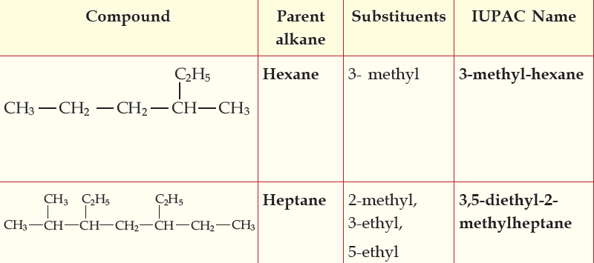
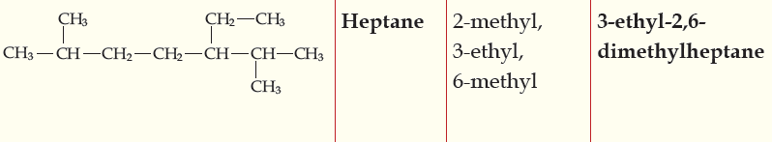
Nomenclature of branched chain alkanes

Slide 16
Alkenes: Acyclic unsaturated compounds containing at least one carbon-carbon double bond are called alkenes. They are also called as olefins (olefiant = oil forming) since the lower members of this class produce oil compounds on reactions with halogens.
Their general formula is, C_{n}H_{2n} where n = 2, 3, 4....
Example: C₂H₄ (ethene or ethylene), C₃H₆ (propene), etc.
In ethene, the carbon-carbon bond is a double bond. Propene has one carbon-carbon single bond and one carbon-carbon double bond.
Alkynes: Acyclic unsaturated compounds containing at least one carbon-carbon triple bond are called alkynes or acetylenes. Their general formula is C_{n}H_{2n-2}, where n = 2, 3, 4 ...
Example: C₂H₂ (ethyne or acetylene), C₃H₄ (propyne), etc.
In ethyne, the carbon-carbon bond is a triple bond. In propyne, there is one carbon-carbon triple bond and one carbon-carbon single bond.

Slide 17
Naming compounds with multiple bonds: If a double or triple bond is present in the compound, the following additional rules are applicable:
(a) The principal chain of carbon atoms is chosen so as to include both the carbons involved in a multiple bond, even if it is not the longest continuous chain.
(b) The position of a multiple bond is indicated by the number given to the carbon atom preceding the multiple bonds.

Slide 18
(c) If the parent carbon chain contains one multiple bond, the carbon atoms of the principal parent chain are numbered in a manner so as to give the lowest number to the multiple bond even if it violates the lowest sum rule (of sum of position of substituents).
(d) If the parent carbon chain contains more than one multiple bond, first check the lowest sum rule for multiple bonds (both double and triple bond positions added collectively irrespective of which is double and which triple). The numbering is done accordingly. If the sum is same from both the ways of numbering (i.e. from left and from right), then give priority to double bond over triple bond, i.e. that numbering is done which gives a lower position to double bond.

Slide 19
(e) While writing the IUPAC name, the “en” (for double bond) or “yne” (for triple bond) and “en-yne” (for both double and triple bonds present) is used in place of “ane”.

Slide 20
B. Nomenclature of Compounds having Functional Groups (when more than one functional groups are present
Priorities of Substituents and Functional Groups
LISTED HERE FROM HIGHEST TO LOWEST PRIORITY
Functional Groups Indicated By Prefix Or Suffix

Slide 21
Step 1. Find the highest priority functional group. Determine and name the longest
continuous carbon chain that includes this group.
Step 2. Number the chain so that the highest priority functional group is assigned the
lower number.
Step 3. If the carbon chain includes multiple bonds, replace “ane” with “ene” for an alkene or “yne” for an alkyne. Designate the position of the multiple bond with the number of the first carbon of the multiple bond.
Step 4. If the molecule includes functional groups, replace the last “e” with the suffix of the highest priority functional group, and include its position number.
Step 5. Indicate all substituents, and functional groups of lower priority, with a prefix. Place the prefixes, with appropriate position numbers, in alphabetical order before the root name.

Slide 24
Halo, alkoxy groups form only prefix names and are put in an alphabetical order preceded by their locants, just like the other substituents.

Slide 27
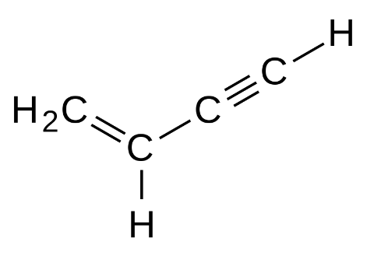
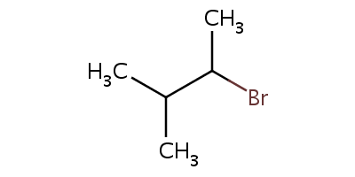
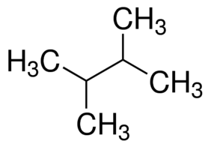
IUPAC naming rules for alkanes, alkenes and alkynes
Examples:
CH₂=C(CH₃)−CH=CH₂
2-methyl-1,3-butadiene
But-1-en-3-yne
NO₂
2-bromo-3-methylbutane
4-nitro but-1-en-3-yne
2,3-dimethylbutane

Slide 28
IUPAC naming rules for benzene derivatives
Monosubstituted Benzene: When one of the positions on the ring has been substituted with another atom or group of atoms, the compound is a monosubstituted benzene.
If two positions are replaced, then it's a disubstituted, & so on.
Many of the monosubstituted compounds have their own name.

Slide 29




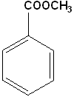

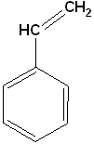




IUPAC naming rules for benzene derivatives
Examples of monosubstituted benzenes:
Benzene carboxamide
OR Benzamide
Methyl benzene
Ethyl benzene
Benzene carboxylic acid
OR Benzoic acid
Methyl benzenecarboxylate
OR Methyl benzoate
Methyl phenyl ether
OR Anisole
Benzenol
OR Phenol
OR Hydroxybenzene
Bromobenzene
Benzenal
OR Benzene carbaldehyde
OR Benzaldehyde
OR Formyl benzene
Benzenamine
OR Aniline
OR Aminobenzene
Ethenyl benzene

Slide 30
IUPAC naming rules for benzene derivatives
Disubstituted Benzenes: When two of the positions on the ring has been substituted with another atom or group of atoms, the compound is a disubstituted benzene.
There is a separate nomenclature to describe the relative positions. Using methyl benzene as the example, the ortho orientation is the 1,2 relationship; the meta is 1,3 and the para is 1,4.
Note that there are two ortho and two meta positions, but only one para.

Slide 31
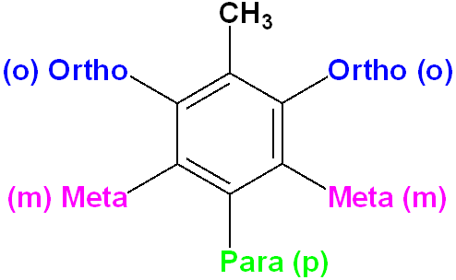
IUPAC naming rules for benzene derivatives
Disubstituted Benzenes:
1
2
2
3
3
4
Methyl benzene

Slide 32
IUPAC naming rules for benzene derivatives
The highest priority functional group should get the least possible number on the ring
Substituents should be arranged in the alphabetical order while naming.
Where one group imparts a special name, the compound can be named as a derivative of that molecule.
If neither group imparts a special name, locate the groups & alphabetize.
1
6
2
5
3
4

Slide 33
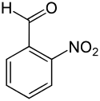

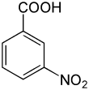
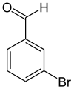

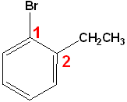
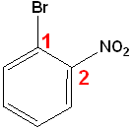
IUPAC naming rules for benzene derivatives
Examples of disubstituted benzenes:
3-nitro benzoic acid
2-nitro benzaldehyde
3-bromo benzaldehyde
4-chloro aniline
1-Bromo-2-ethylbenzene
1-Bromo-2-nitrobenzene
1-Bromo-4-nitrobenzene

Slide 34
Concept of Hybridization

Slide 35
Hybrid Orbitals
Hybridization of orbitals (L. Pauling)
The combination of two or more atomic orbitals forms a new set of atomic orbitals, called hybrid orbitals
We deal with three types of hybrid orbitals
sp³ (one s orbital + three p orbitals)
sp² (one s orbital + two p orbitals)
sp (one s orbital + one p orbital)
Overlap of hybrid orbitals can form two types of bonds depending on the geometry of overlap
σ bonds are formed by “direct” or head-on overlap
π bonds are formed by “parallel” or sideways overlap

Slide 36
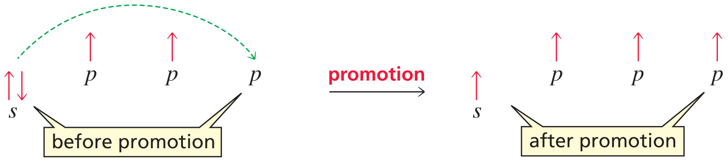
sp³ Hybridization
Notes:
Figure: 01-08-03UN
Title:
sp³ Hybridization.
Caption:
A carbon atom has a 2s electron promoted to a 2p orbital. Promotion of a 2s electron to a 2p orbital is needed so that carbon has four unpaired electrons.

Slide 37
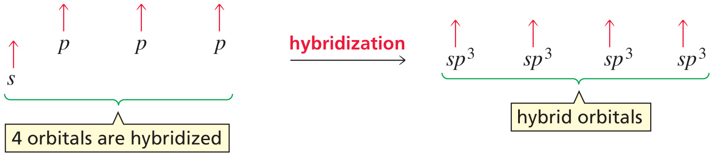
sp³ Hybridization
Notes:
Figure: 01-08-04UN
Title:
sp³ Hybridization.
Caption:
One s and three p orbitals are hybridized to form an sp³-hybridized orbital.

Slide 38
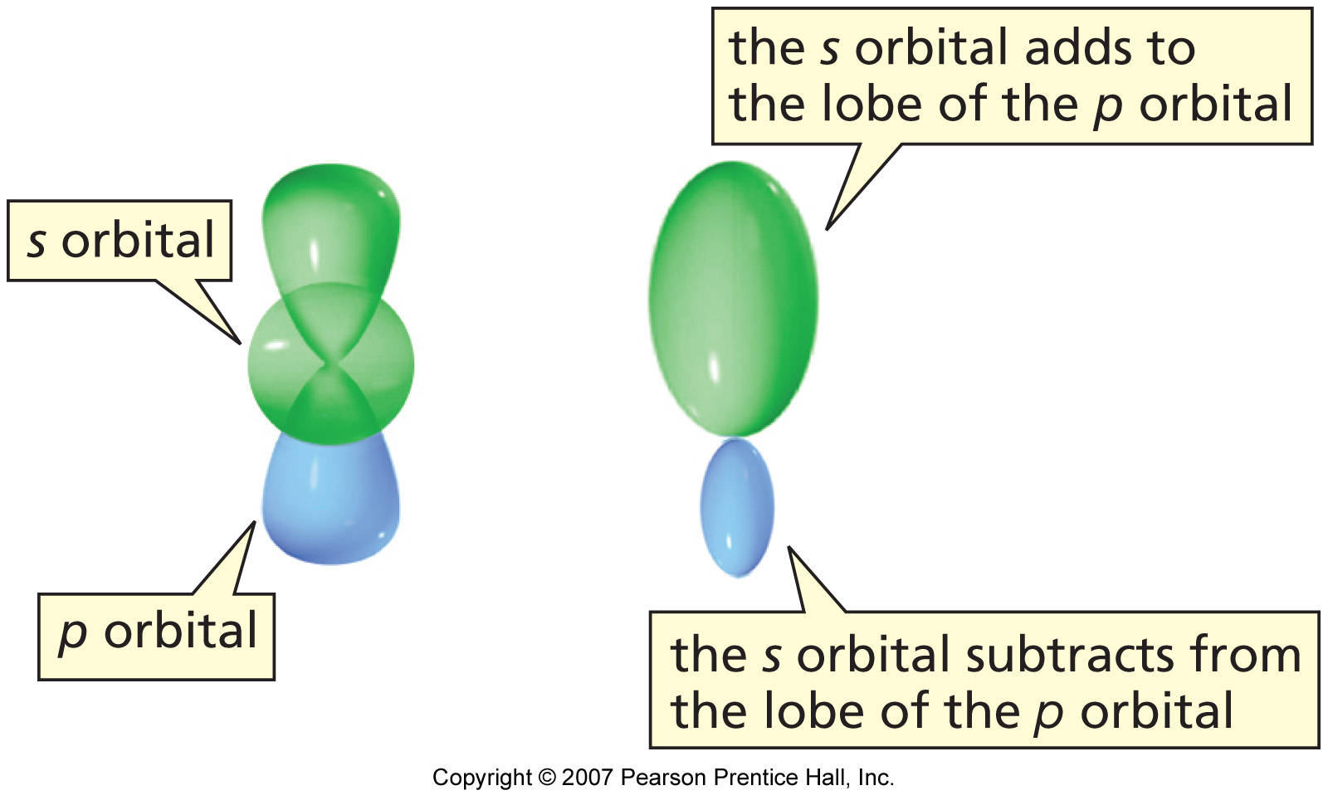
sp³ Hybridization
Notes:
Figure: 01-09
Title:
Figure 1.9. Formation of sp³ hybrid orbital.
Caption:
The s orbital adds to one lobe of the p orbital and subtracts from the other lobe of the p orbital.

Slide 39
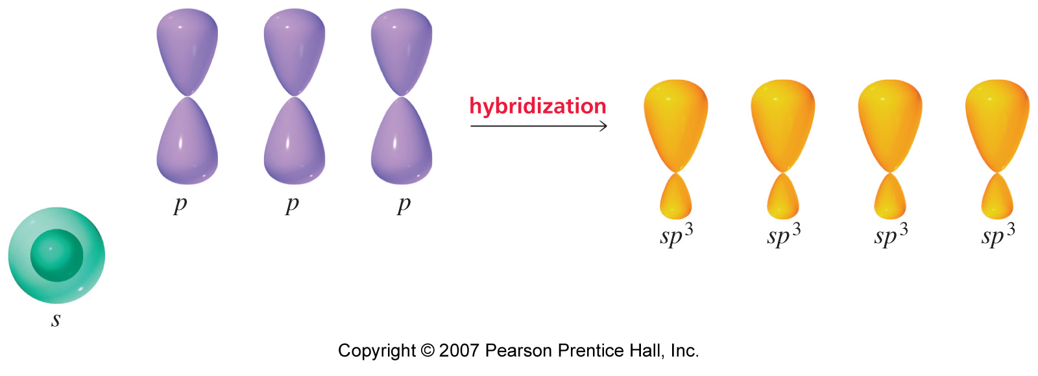
sp³ Hybridization
Notes:
Figure: 01-10
Title:
Figure 1.10. Formation of four sp³ hybrid orbitals.
Caption:
One s atomic orbital combines with three p atomic orbitals to make four sp³ hybrid orbitals.

Slide 40
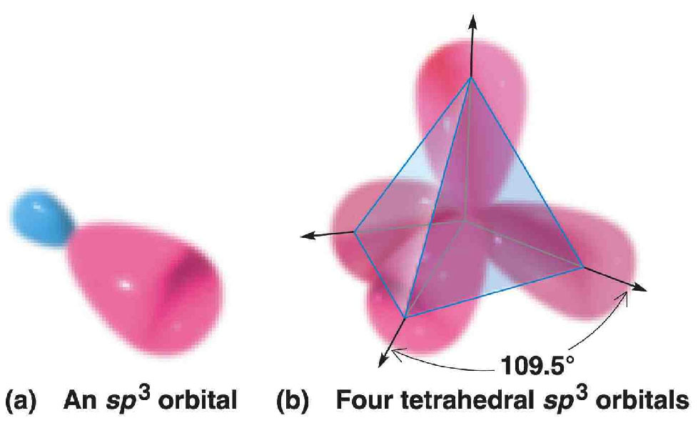
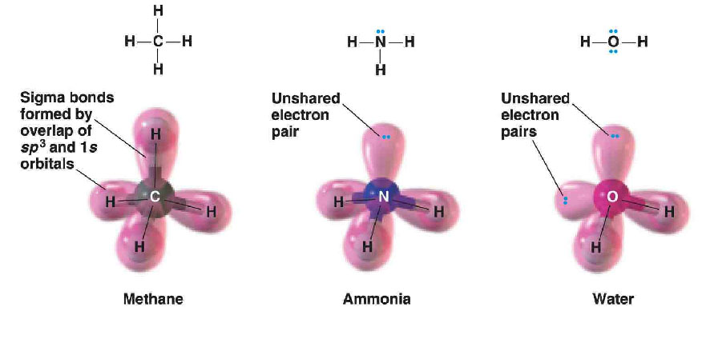
sp³ Hybrid Orbitals
The four sp³ hybrid orbitals are directed toward the corners of a regular tetrahedron at angles of 109.5°
Ex. Orbital overlap pictures of methane, ammonia, and water

Slide 41
sp³ Hybridization of Methane CH4
Let us try to understand the sp³ hybridization with the help of structure of methane (CH₄). The electronic configuration of a carbon atom in its lowest energy stateº, called the ground state is represented below where there are only two unpaired electrons. But for the formation of a molecule like CH₄, 4 unpaired electrons are required. Thus, the carbon atom gets excited to a higher energy state (one electron from 2s is excited to 2p) called the excited state .
The carbon atom now has the required four electrons and must combine with four hydrogen atoms to form a methane molecule.

Slide 42
In hybridization, equal number of hybrid orbitals result from reorganization of atomic orbitals. Here, the four atomic orbitals, one s orbital (2s) and three p orbitals (2px , 2py , and 2pz ) undergo hybridization and give rise to an equal number of (i.e., four sp3) hybrid orbitals.
One s + Three p Four s1p3 or sp3
Atomic orbitals Hybrid orbitals
These are called sp3 hybrid orbitals as they have one part the character of an s orbital and three parts the character of a p orbital. They arrange themselves, with the maximum separation from each other, in a tetrahedral manner and 109°28' as the angle of orientation with respect to each other as shown in

Slide 43
sp³ Hybridization of Methane CH4
These four sp3 hybrid orbitals now overlap with the s orbitals of four hydrogen atoms (one each) to give a tetrahedral structure for methane having all equivalent C-H sigma bonds and all bond angles as 109°28' or 109.5°

Slide 44
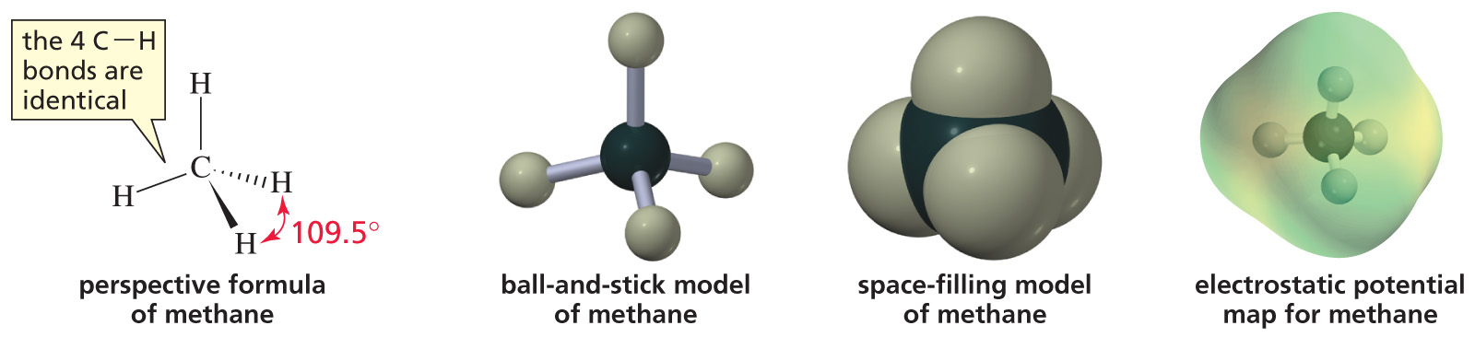
sp³ Hybridization of Methane CH4
Notes:
Figure: 01-08-02UN
Title:
Models of methane.
Caption:
The ball-and-stick model, the space-filling model, and the electrostatic potential map are shown for methane.

Slide 45
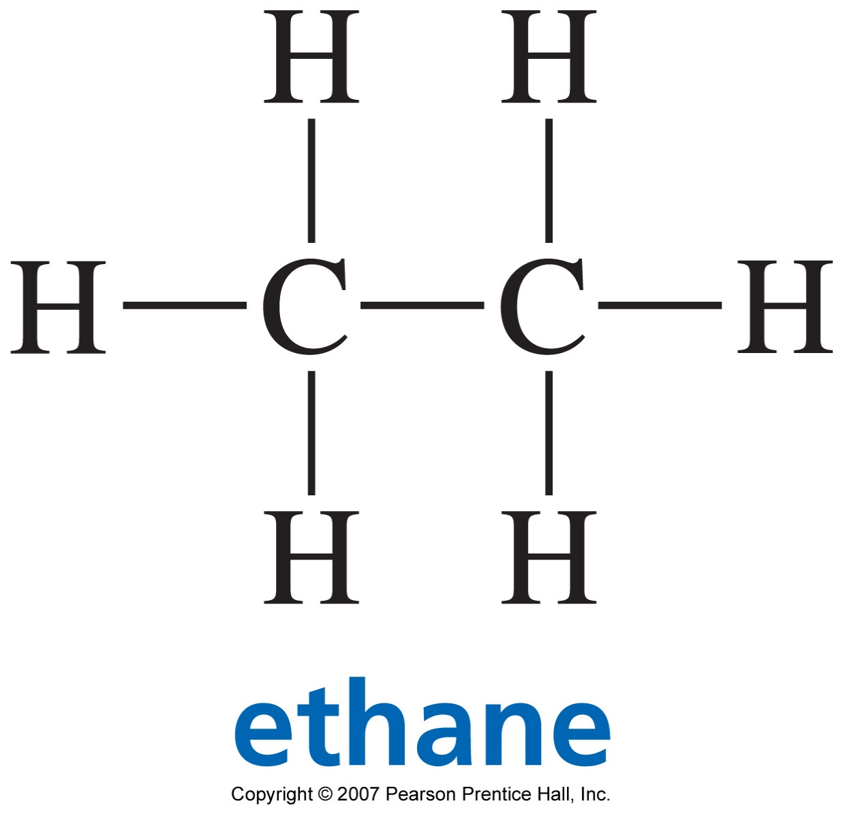
sp³ Hybridization of Ethane C₂H₆
Notes:
Figure: 01-11-01UN
Title:
Bonds in ethane.
Caption:
The two carbon atoms in ethane are tetrahedral. Each carbon uses four sp³ orbitals to form four covalent bonds.

Slide 46
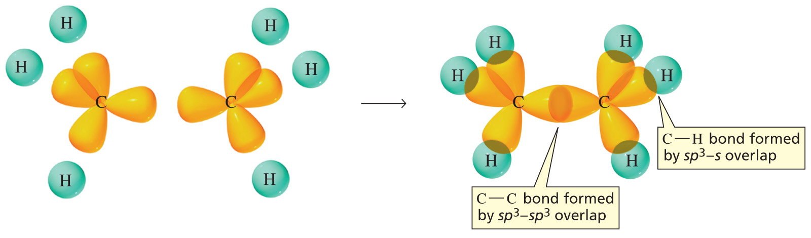
sp³ Hybridization of Ethane C₂H₆
Notes:
Figure: 01-12
Title:
Figure 1.12. Bonding in ethane.
Caption:
The carbon-carbon bond is formed by sp³-sp³overlap, and each carbon-hydrogen bond is formed by sp³-s overlap.

Slide 47
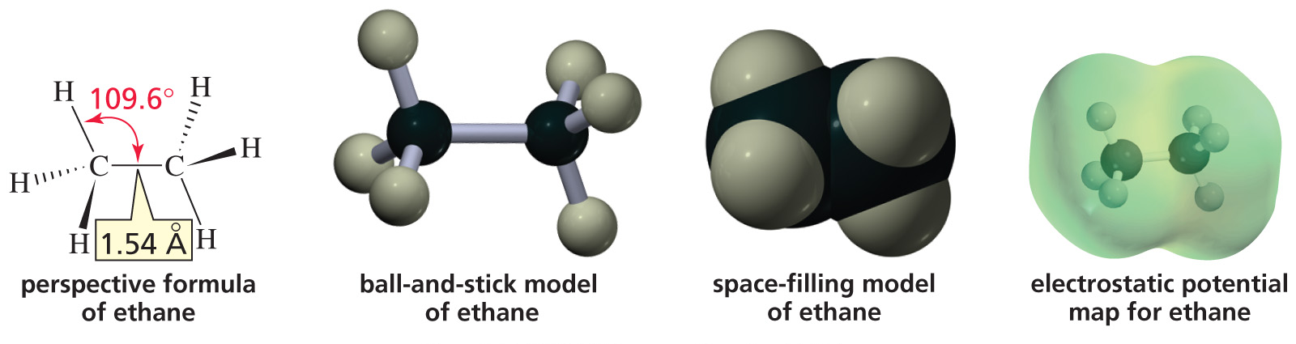
sp³ Hybridization of Ethane C₂H₆
Notes:
Figure: 01-12-01UN
Title:
Structure of ethane.
Caption:
The two carbons in ethane are tetrahedral. Each carbon uses four sp³ atomic orbitals to form four covalent bonds.

Slide 48
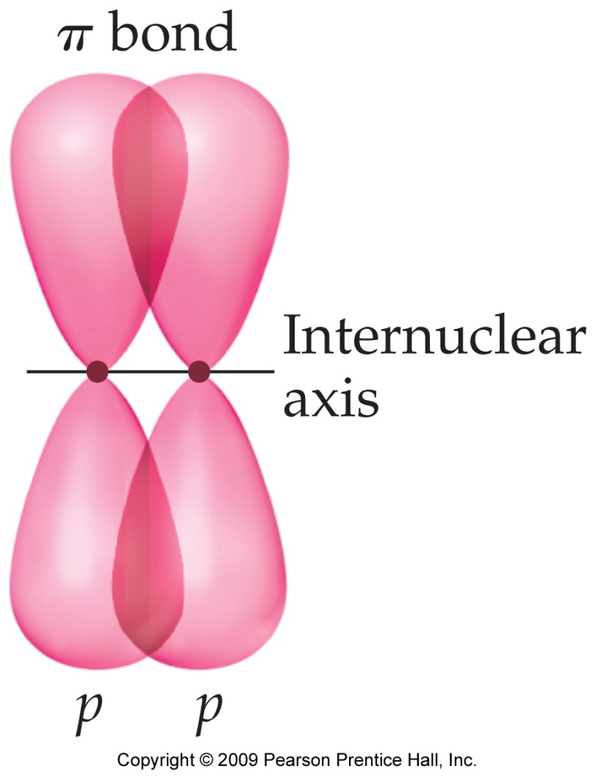
Multiple bonds
Multiple bonds result from the overlap of the p orbitals in a parallel or sideways fashion as shown
The bond formed by such an overlap is called a π-bond and is perpendicular to the internuclear axis
Thus, in a π-bond, the electron density is above and below the plane bearing the σ- bond

Slide 49
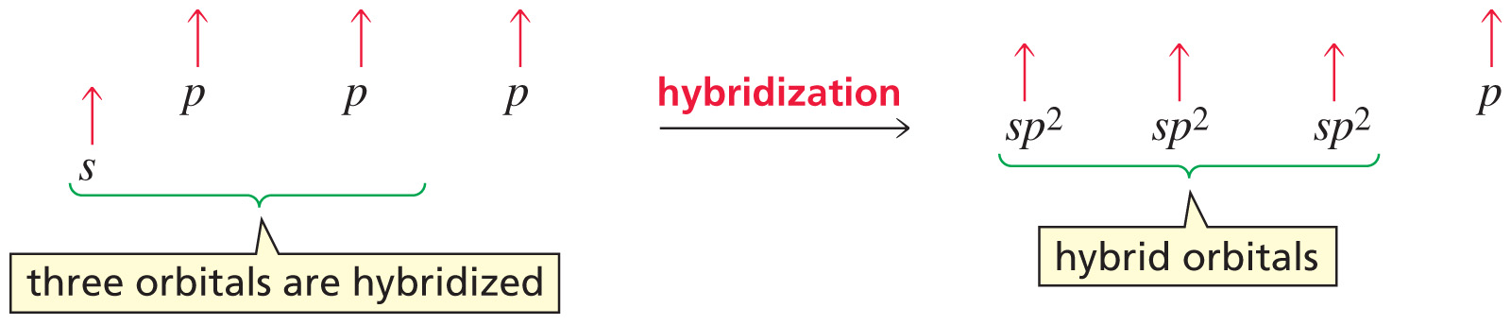
sp² Hybridization
Notes:
Figure: 01-13-02UN
Title:
sp² Hybridization.
Caption:
A carbon atom has a 2s electron promoted to a 2p orbital. One s and two p orbitals are hybridized to form an sp²-hybridized orbital.

Slide 50
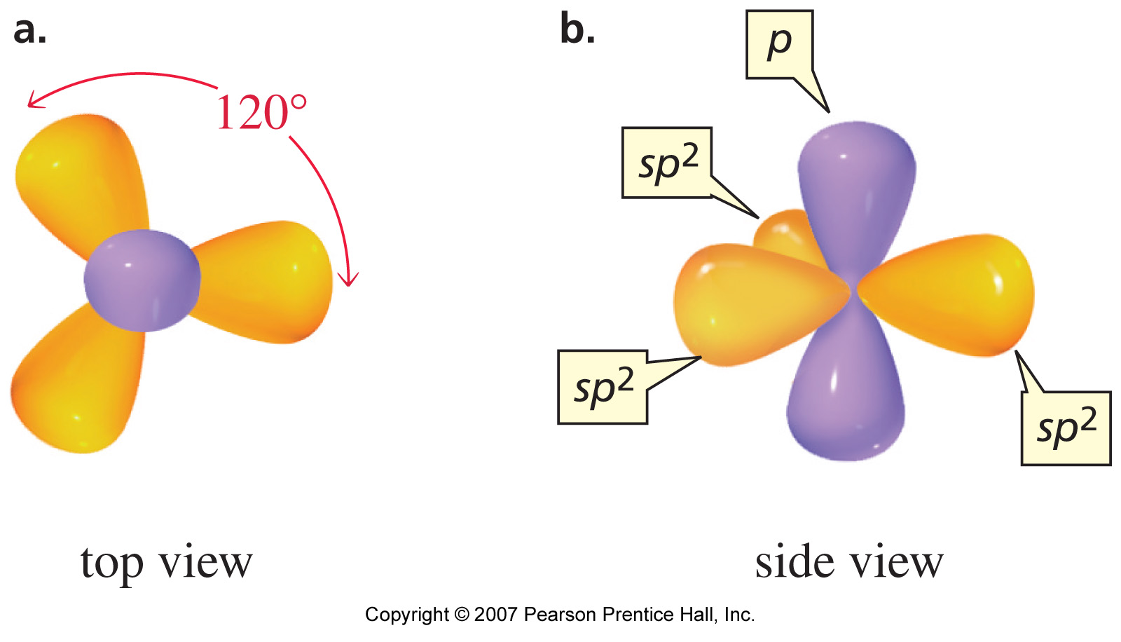
sp² Hybridization
Notes:
Figure: 01-14
Title:
Figure 1.14. sp² Hybrid orbitals.
Caption:
(a) The three sp² hybrid orbitals lie in a plane. (b) The unhybridized p orbital is perpendicular to the plane.

Slide 51
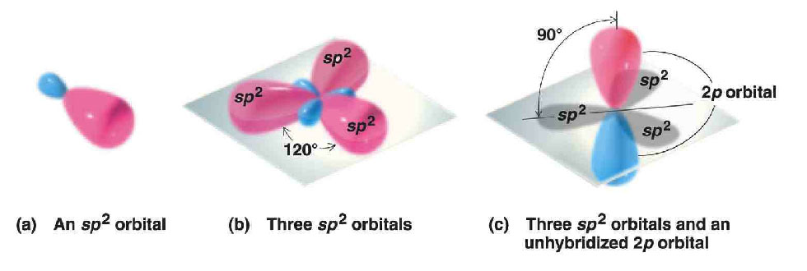
sp² Hybrid Orbitals
The axes of the three sp² hybrid orbitals lie in a plane and are directed toward the corners of an equilateral triangle
The unhybridized 2p orbital lies perpendicular to the plane of the three hybrid orbitals

Slide 52
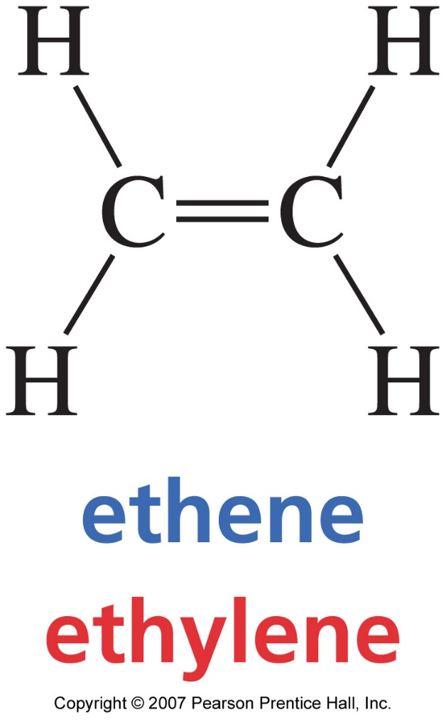
sp² hybridization in ethene
Notes:
Figure: 01-13-01UN
Title:
Ethene, ethylene.
Caption:
Ethene contains a carbon-carbon double bond.

Slide 53
sp² hybridization in ethene
Let us try to understand the sp² hybridization with the help of structure of ethene (C₂H₄). In ethene, the carbon-carbon double bond has one σ(sigma) bond and one π (pi) bond. Each carbon is further attached to two hydrogen atoms by s bonds as shown below :
The excited states of each carbon can be shown as in below Figure

Slide 54
Thus, one of the 2py or 2px orbitals of one carbon atom overlaps sideways with 2py or 2px orbitals of the other carbon atom (here, let us say 2px) respectively to form the p bond as shown in Figure
Now, in the valence shell, each carbon atom is left with one s orbital (2s) and two p orbitals (2pz and 2py), which undergo hybridization and give rise to three sp2 hybrid orbitals.
One s + Two p sp2
Atomic orbitals Hybrid orbitals
These are called sp2 hybrid orbitals to indicate that they have one part the character of s orbital and two parts the character of a p orbital. These three sp2 orbitals are directed towards the corners of a regular triangle with angles of 120° between them.

Slide 55
sp² Hybridization in ethene
The unhybridised p (2px) orbital is perpendicular to the plane of the triangle formed by the sp² hybrid orbitals. This gives the structure of ethene as shown in Figure:
There are a total of five sigma bonds in the ethene molecule. One carbon-carbon sigma bond formed via the overlap of one sp² hybrid orbital of each carbon. Four carbon-hydrogen sigma bonds formed by the remaining two-sp² hybrid orbitals on each carbon overlapping with two hydrogen atoms (one each), i.e. two σ bonds on each carbon atoms. The bond angle between each bond is 120°. All the six atoms (two carbon and four hydrogen) lie in the same plane and the π orbitals are perpendicular to this plane. Ethene has thus a planar structure

Slide 56
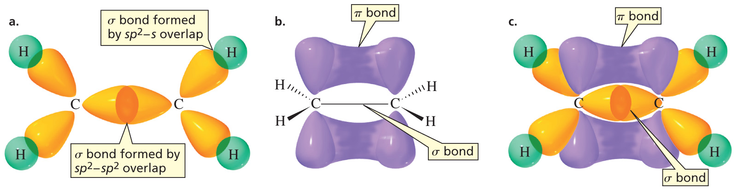
sp² Hybridization in ethene
Notes:
Figure: 01-15
Title:
Figure 1.15. Structure of a double bond.
Caption:
(a) One C-C bond in ethene is a sigma bond formed by sp²-sp² overlap, and the C-H bonds are formed by sp²-s overlap. (b) The second C-C bond is a pi bond formed by the side-to-side overlap of a p orbital of one carbon with a p orbital of the other carbon. (c) There is an accumulation of electron density above and below the plane containing the two carbons and four hydrogens.

Slide 57
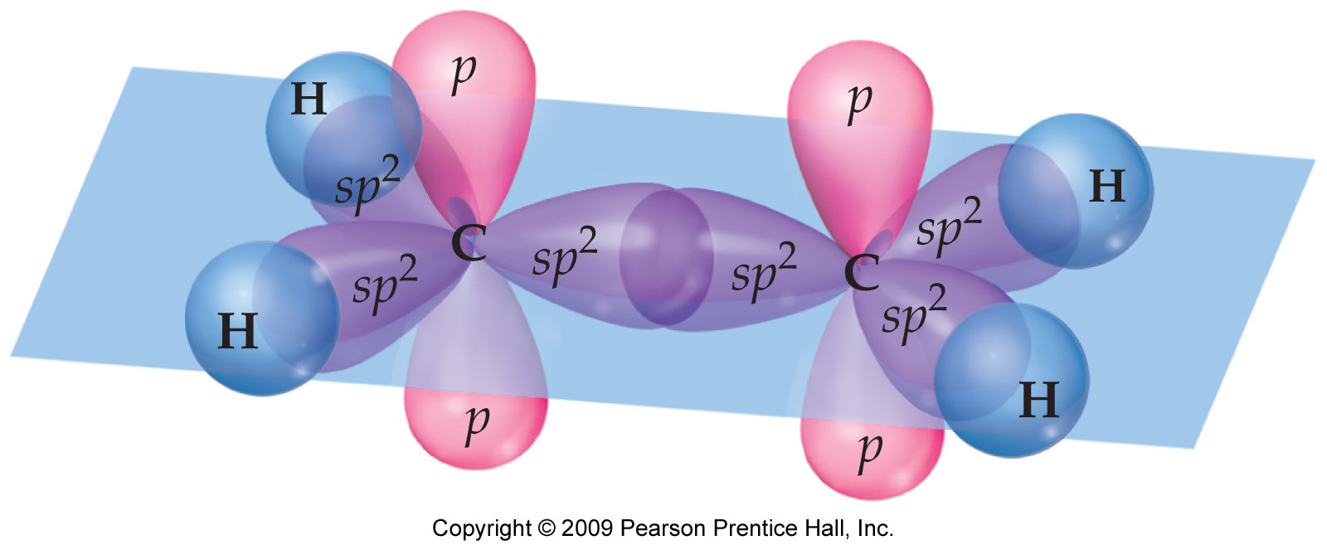
Summary of σ - bonding in ethylene (C₂H₄)
Each C ─ H σ-bond is formed by the overlap of the sp² hybridized orbital of C with the 1s orbital of H-atom. Four out of the six sp² hybridized orbital of the two C's are used up this way
The remaining two sp² hybridized orbitals of the two C's overlap with each other to form the C ─ C σ-bond

Slide 58
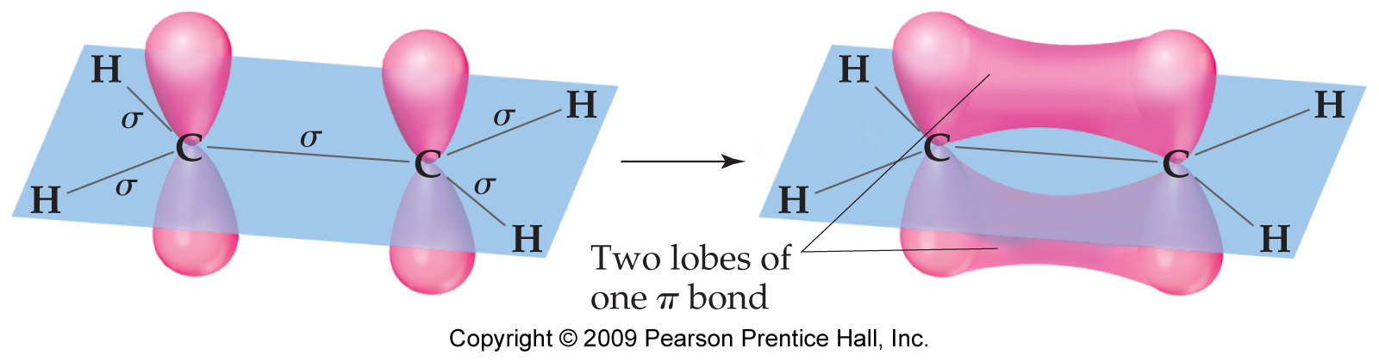
Summary of π - bonding in ethylene (C₂H₄)
Each C has 4 valence electrons
During sp² hybridization only one 2s and two 2p orbitals are used
The remaining unhybridized 2p orbital still has one electron left
These two 2p orbitals overlap sideways to form the C ═ C π-bond
The electron density in the π-bond is located above and below the C ─ C σ-bond axis
Two lobes of one
π-bond

Slide 59
Summary of bonding in ethylene (C₂H₄)
The electron density in the σ-bond is along the line joining the two nuclei i.e. the internuclear axis
The electron density in the π-bond is in a plane perpendicular to the internuclear axis, and lies above and below this plane bearing the internuclear axis

Slide 60
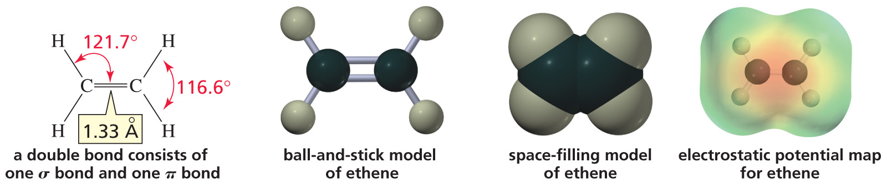
sp² Hybridization in ethene
Notes:
Figure: 01-15-01UN
Title:
Lewis structure, ball-and-stick model, space-filling model, and electrostatic potential map of ethene.
Caption:
Ethene consists of a carbon-carbon double bond and four carbon-hydrogen single (sigma) bonds.

Slide 61
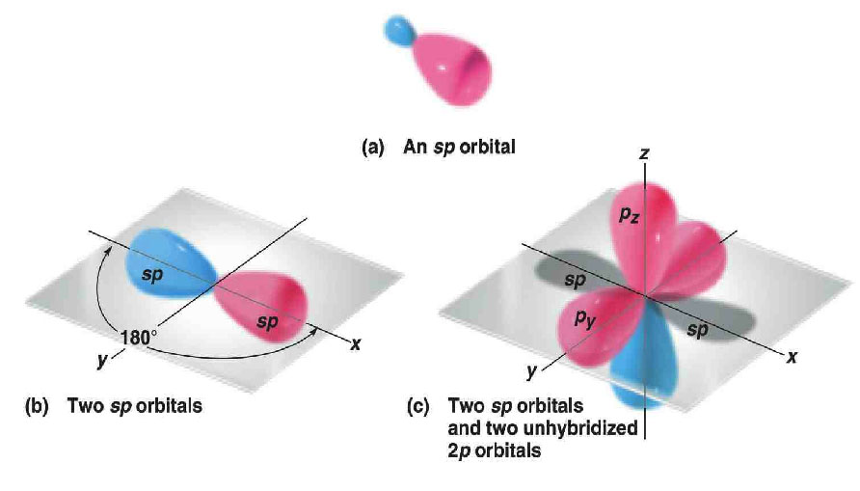
sp Hybrid Orbitals
Two lobes of unequal size at an angle of 180°
The unhybridized 2p orbitals are perpendicular to each other and to the line created by the axes of the two sp hybrid orbitals

Slide 62
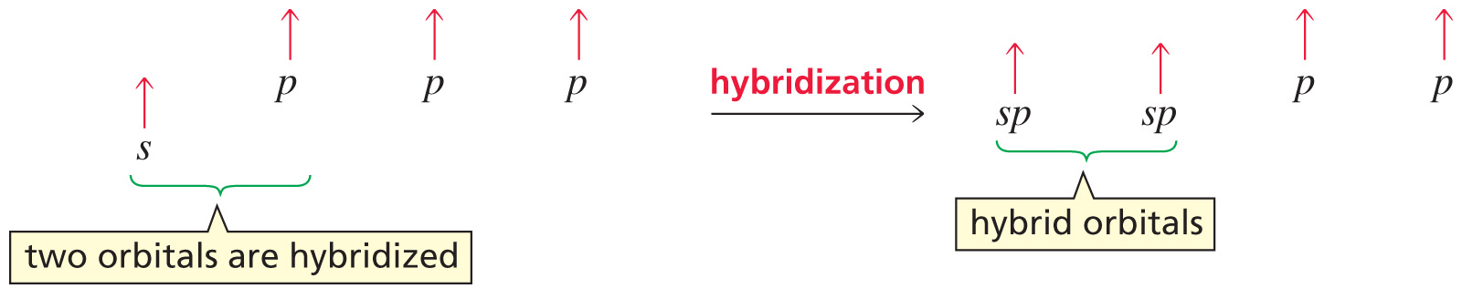
sp Hybridisation
Notes:
Figure: 01-15-03UN
Title:
sp Hybridization.
Caption:
A carbon atom has a 2s electron promoted to a 2p orbital. One s orbital and one p orbital are hybridized to form an sp-hybridized orbital.

Slide 63
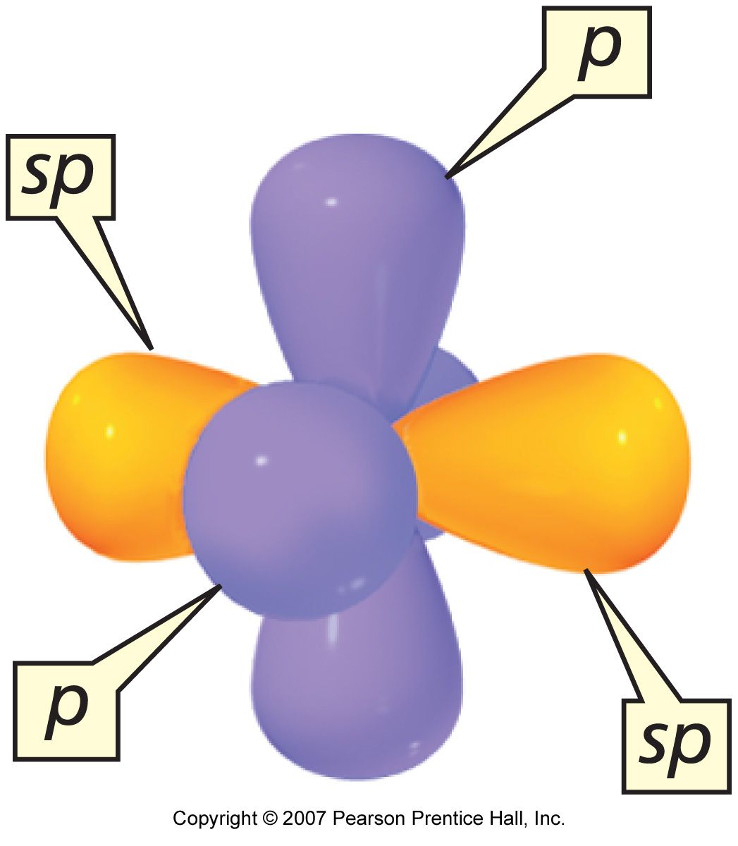
sp Hybridisation
Notes:
Figure: 01-16
Title:
Figure 1.16. sp-Hybridized carbon atom.
Caption:
The two sp orbitals are oriented 180 degrees away from each other, perpendicular to the two unhybridized p orbitals.

Slide 64
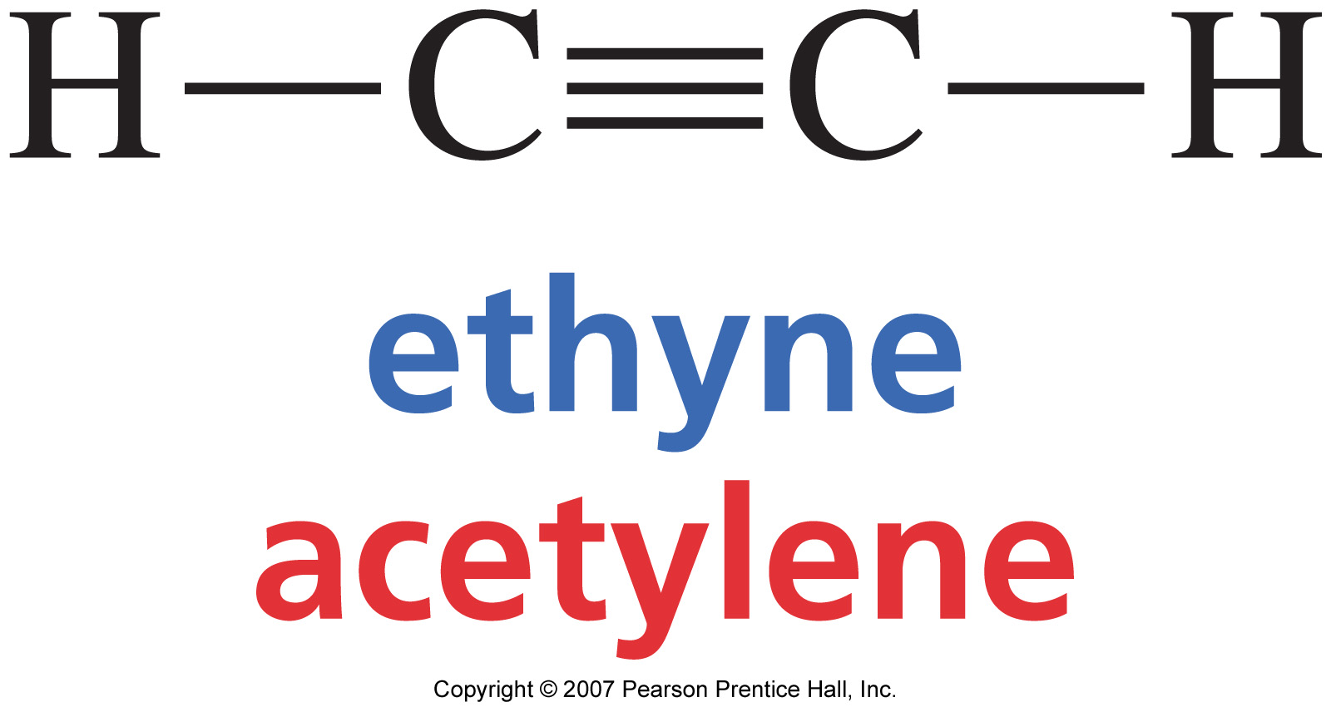
sp Hybridisation in ethyne (i.e. acetylene)
Notes:
Figure: 01-15-02UN
Title:
Ethyne, acetylene.
Caption:
Ethyne contains a carbon-carbon triple bond and two carbon-hydrogen single bonds.

Slide 65
sp Hybridisation in ethyne (i.e. acetylene)
Let us try to understand the sp hybridization with the help of structure of ethyne (C₂H₂). In ethyne, the carbon-carbon triple bond has one s(sigma) bond and two p (pi) bonds as shown below :
As earlier, the excited states of each carbon atom can be shown as follows:

Slide 66
sp Hybridisation in ethyne (i.e. acetylene)
Let us assume Z to be the internuclear axis, then the 2py and 2px of one-carbon overlap sideways with a 2py and 2px of the other carbon atom respectively to form two π bonds. Each carbon atom is left with one s orbital (2s) and one p orbital (2pz), which undergo hybridization and give rise to two sp hybrid orbitals.
One s + One p sp
Atomic orbitals Hybrid orbitals
These hybrid orbitals are called sp orbitals to indicate that they have one part the character of the s orbital and one part the character of the p orbital. These two sp hybrid orbitals are directed in a linear fashion with angles of 180° between them

Slide 67
sp Hybridisation in ethyne (i.e. acetylene)
One sp hybrid orbital of each carbon overlaps to form a carbon-carbon sigma bond. The remaining sp hybrid orbital on each carbon overlaps with one hydrogen atom each to give two sigma bonds. Thus a total of three sigma bonds are found in the ethyne molecule. The bond angle between each bond is 180°. Acetylene is a linear molecule as all the four atoms (two carbon and two hydrogen) lie along the same straight line. Also, it has a cylindrical symmetry about the inter-nuclear axis due to the p electron cloud present in a cylindrical manner.

Slide 68
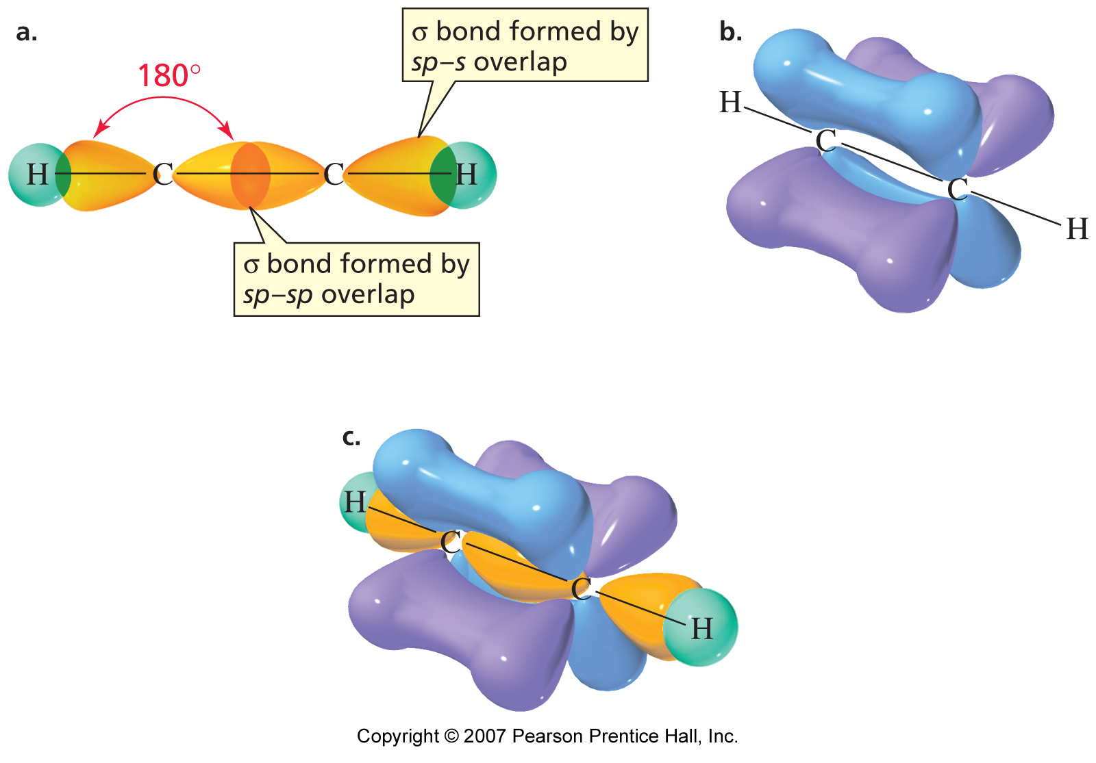
sp Hybridisation in ethyne (i.e. acetylene)
Notes:
Figure: 01-17
Title:
Orbital structure of ethyne.
Caption:
(a) The C-C sigma bond in ethyne is formed by sp-sp overlap, and the C-H bonds are formed by sp-s overlap. The carbon atoms and the atoms bonded to them are in a straight line. (b) The two carbon-carbon pi bonds are formed by the side-to-side overlap of the p orbitals of one carbon with the p orbitals of the other carbon. (c) The triple bond has an electron-dense region above and below and in front of and in back of the internuclear axis of the molecule.

Slide 69
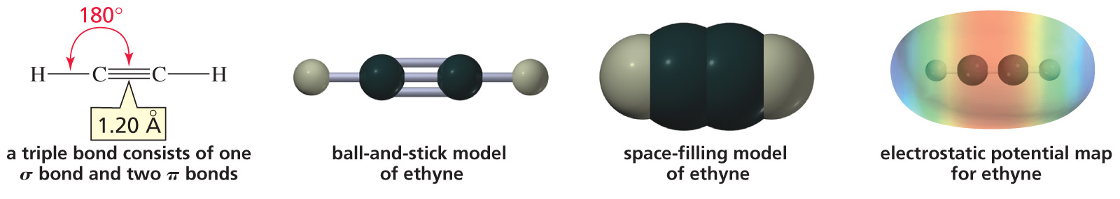
sp Hybridisation in ethyne (i.e. acetylene)
Notes:
Figure: 01-17-01UN
Title:
Lewis structure, ball-and-stick model, space-filling model, and electrostatic potential map of ethyne.
Caption:
A carbon-carbon triple bond consists of three pairs of electrons.

Slide 70
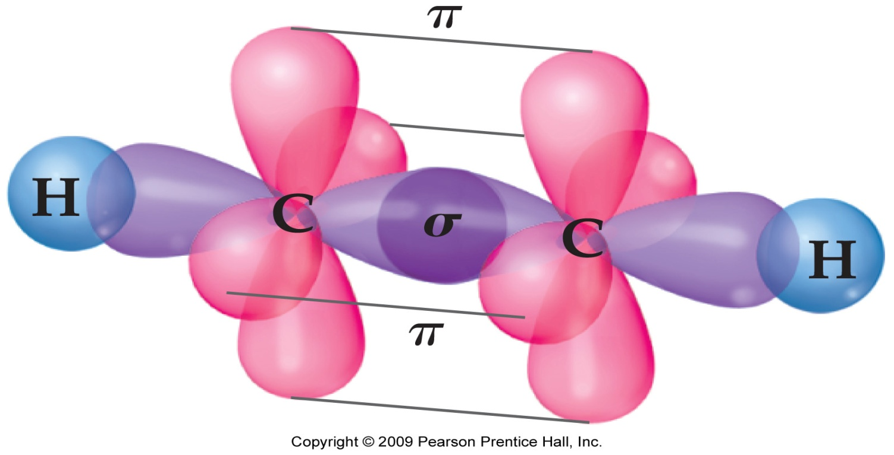
Summary of σ - bonding in acetylene (C₂H₂)
Each C ─ H σ-bond is formed by the overlap of the sp hybridized orbital of C with the 1s orbital of H-atom. Two out of the four sp hybridized orbitals of the two C's are used up this way
The remaining two sp hybridized orbitals of the two C's overlap with each other to form the C ─ C σ-bond

Slide 71
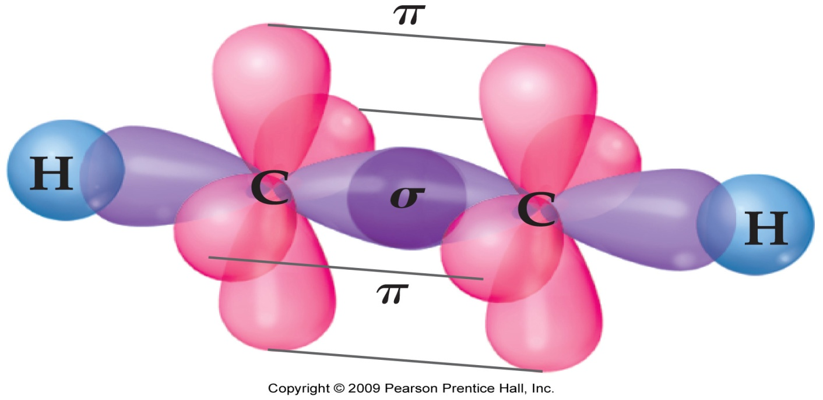
Summary of π - bonding in acetylene (C₂H₂)
Each C has 4 valence electrons
During sp hybridization only one 2s and one 2p orbital of each C, is used
The remaining two unhybridized 2p orbitals of each C still have one electron left
These two 2p orbitals overlap sideways to form the two C ═ C π-bonds in acetylene
The electron density one π-bond is located above and below the C ─ C σ-bond axis
The electron density of the other π-bond is located in front and behind the C ─ C σ-bond axis

Slide 72
OR

